Slide 1





Solving Crime with Data
A CDMB Investigation
An ISYS 864 initiative
A Project by Detectives
Priya Prachi Vidhi
CDMB

Slide 2

Case Brief - What is CDMB?
Crime Data Management Bureau (CDMB)
A centralized database system to assist law enforcement with investigating serious crimes like homicides, kidnappings, and robberies.
Goal
Establish criminal patterns, connect entities (suspects, victims, officers, scenes), and solve crimes using data.

Slide 3






ENTITIES & ATTRIBUTES
Crime
Victim
Suspect
Type(Homicide, Suicide, Kidnapping)
, Date, description, status
Injury type, name, DOB, Address,
Phone number
Name, DOB, Address, Criminal Record,
Last Known Loc, Current Status
Crime Scene
Officer
Forensics
DNA, Post Mortem Performed,
Blood Type, Toxicology report result,
Est. Death Time
Location type, Address
Evidence collected,
Security cameras
Name, SupervisorID, Precinct,
Rank, Specialization

Slide 4




OUR APPROACH
Data
SQL
Insight
Solution
Collect crime information
From multiple sources
Query relationships
Discover connections
and patterns
Solve the case
Or prepare the data to be further
analyzed
Use views, joins,
triggers to simulate detective work

Slide 5

BUSINESS RULES
Each Crime can have many Victims
Each victim must be associated with exactly one crime
Each crime must have at least one(many) suspect(suspects)
Each suspect can be linked to many crimes
Each crime must be assigned to exactly one officer
Each officer can be assigned to many crimes
Each Supervisor must supervise at least one(many) officer
Each officer must be supervised by only one Supervisor
Each crime must have at least one(many) crime scenes
Each crime scene must be associated with exactly one crime
Each crime can have many Forensics reports
Each Forensics report must be produced for only one Crime

Slide 6
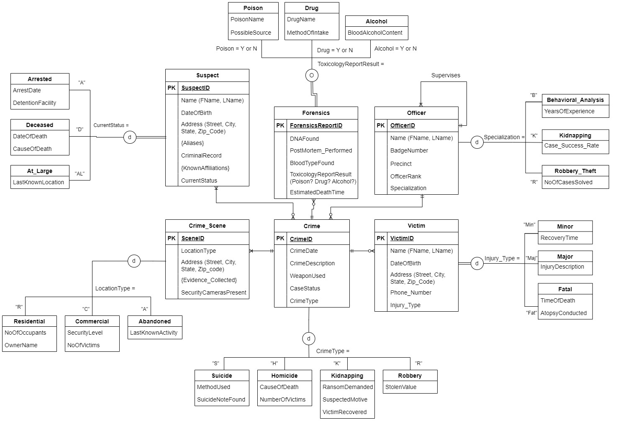
ER DIAGRAM

Slide 7
RELATIONAL
MODEL
Notes:
Now I’ll walk you through how we translated our ER diagram into the relational model, focusing on the different types of conversions we handled

Slide 8
RELATIONAL
MODEL
Notes:
First, we converted each entity and relationship from the ER Diagram into a set of normalized relational tables. To meet 3NF requirements, we eliminated partial and transitive dependencies - this means every non-key attribute depends only on the primary key.

Slide 9
RELATIONAL
MODEL
Notes:
Next, all the composite and multivalued attributes, like those in the Crime Scene, were carefully broken down to maintain 3NF compliance.

Slide 10
RELATIONAL
MODEL
Notes:
Then, we modeled many-to-many relationships, such as between Crime and Suspect, using a junction table with a composite primary key of CrimeID and SuspectID.

Slide 11
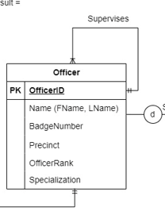
RELATIONAL
MODEL
Notes:
After that, For unary relationships in the Officer table — where one officer reports to another — we added a SupervisorID that points back to the same table.

Slide 12
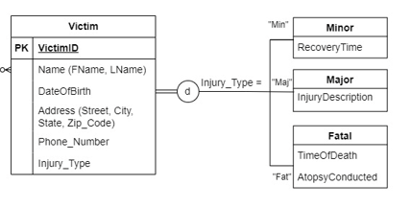
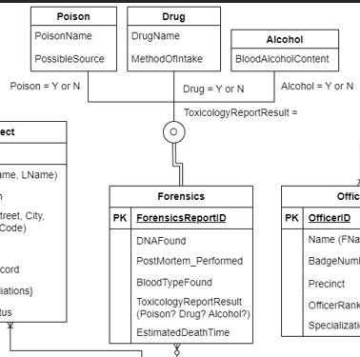
RELATIONAL
MODEL
Notes:
Finally, we also modeled subtypes. For Victims, we created separate tables for Minor, Major, and Fatal injuries, ensuring one victim appears in only one of these. For Forensics, since a report can involve multiple substances, we allowed overlapping subtypes by creating separate tables for each - Poison, Drug, and Alcohol

Slide 13
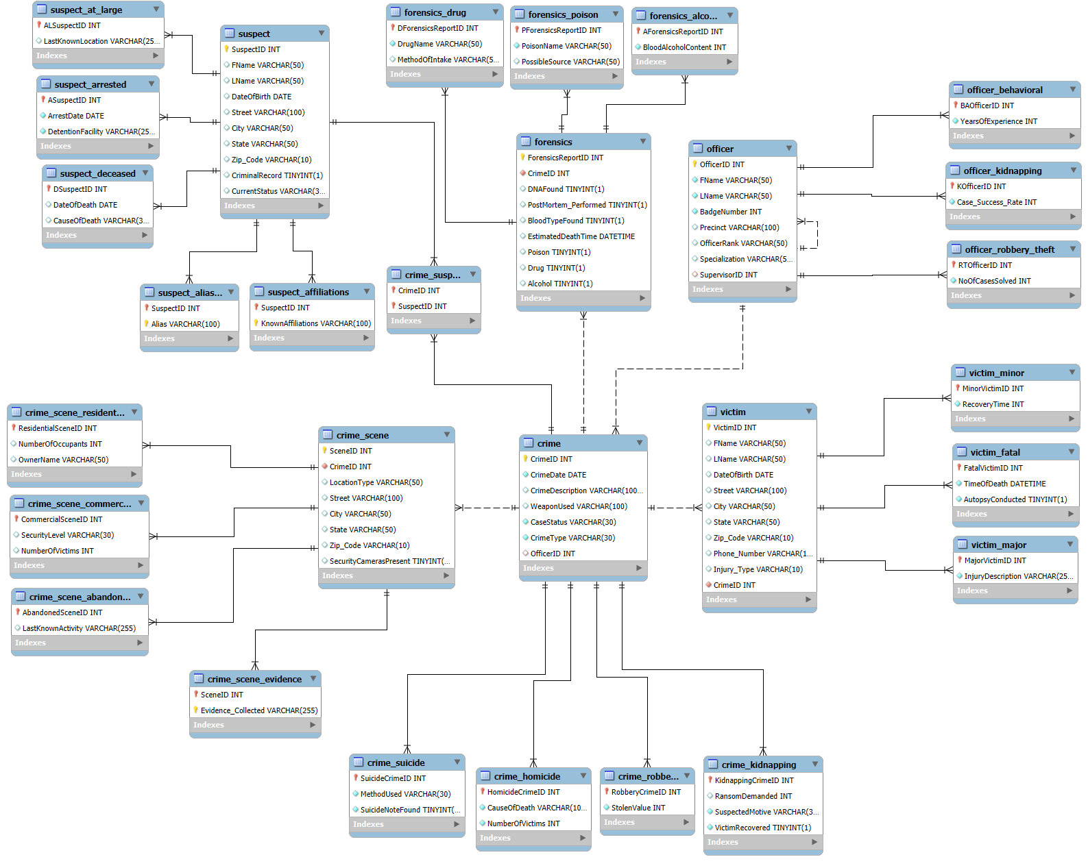
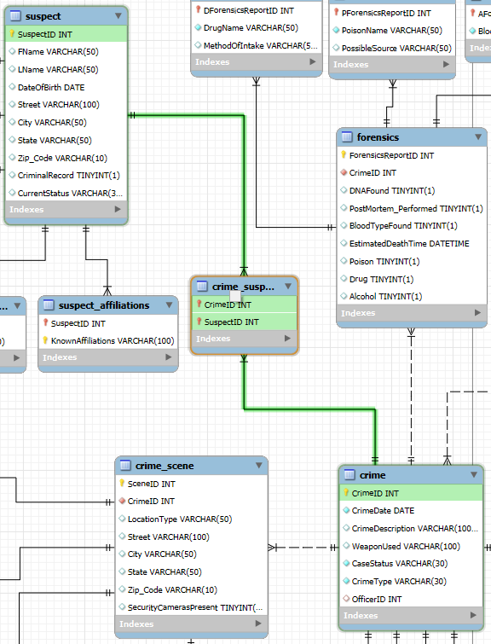
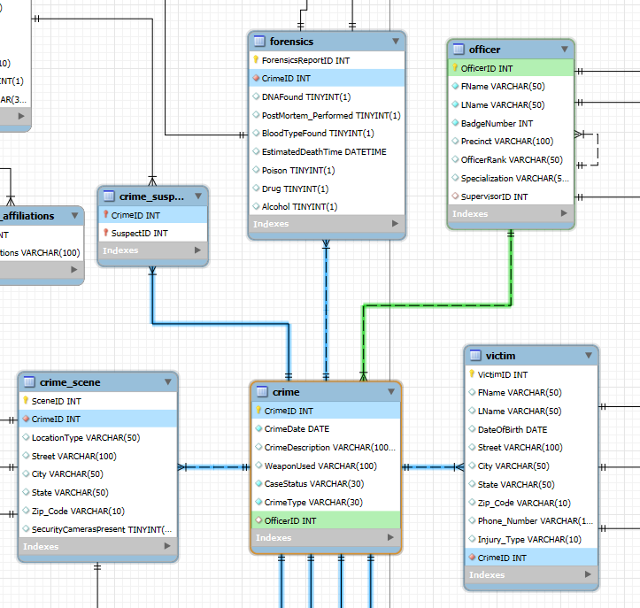
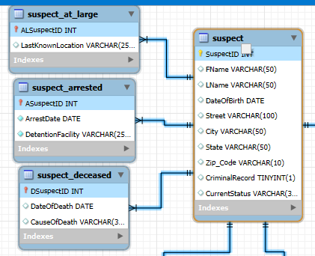
EER DIAGRAM
Notes:
Let’s take a look at Enhanced ER diagram, generated through reverse engineering in MySQL. It reflects the actual structure of the database - showing how our design decisions were translated into real tables.
Compared to the earlier ER diagram, this version confirms that all foreign key constraints have been properly implemented. These ensure referential integrity.
What stands out here is how clearly the diagram visualizes the flow of relationships. For example, we can see the Crime table acting as a central hub, linking to suspects, victims, officers, and crime scenes.
Subtype tables - like those for suspects - are now physically connected to their parent tables,
and junction tables like Crime_Suspect are visibly bridging many-to-many relationships.
So overall, this diagram helps us double-check that our design is working as intended- fully normalised and aligned with our business rules.

Slide 14

INVESTIGATION SCENARIO
A young woman is found dead in a commercial warehouse on the outskirts of the city.
The victim appears to have suffered major physical injuries and there are signs of a violent struggle.
Nearby, investigators collect blood samples and potential weapon residues.
There are no surveillance cameras on-site, and the property is said to be unoccupied for months. Forensics later reveals possible drug traces in her system.
Goal:
To determine the crime type
Identify any suspects
Connect evidence from the crime scene and forensics to resolve the case
Notes:
To demonstrate our SQL skills in a meaningful way, we decided to present our queries through a fictional investigation.
A young woman is discovered dead in a commercial warehouse on the edge of the city. She suffered severe injuries, and there are clear signs of a violent struggle. Investigators found blood traces and potential weapon residue nearby. However, there were no surveillance cameras and the place had been abandoned for months. Toxicology reports later revealed traces of drugs in her system.
With this data in hand, our investigation began. The goals are to determine the crime type, identify suspects, and connect evidence from different sources to understand what happened.

Slide 15
SOLVING THE CASE
USING EXISTING DATA

Slide 16
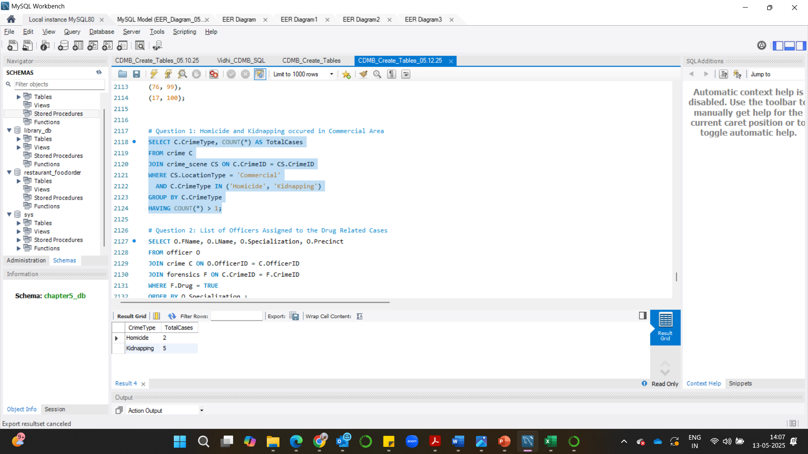
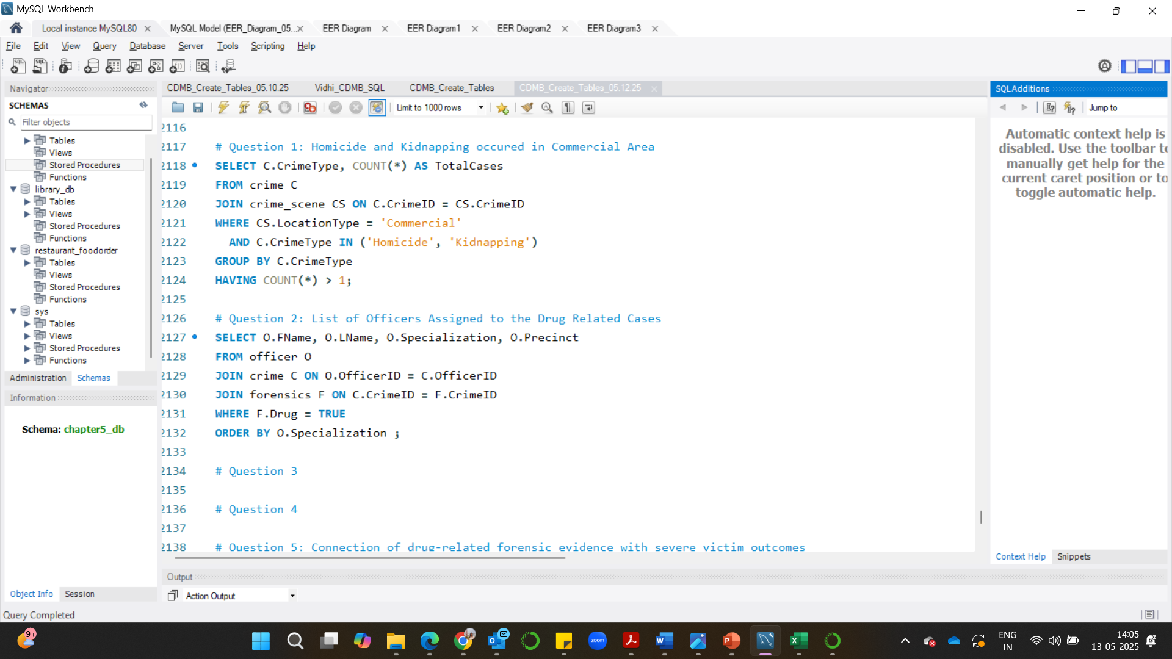
1. Homicide and Kidnapping Occurred in Commercial Area
Output:
To identify patterns of serious violent crimes (specifically homicide and kidnapping) in commercial area
Code:
Notes:
Our first step was to check if similar crimes occurred in commercial zones. Using a JOIN between Crime and Crime_Scene, we filtered for crimes like homicide and kidnapping in commercial areas.
We grouped by crime type and used a HAVING clause to show only those with multiple occurrences. The result: 2 homicides and 5 kidnappings - confirming that this type of location is prone to violent crimes

Slide 17
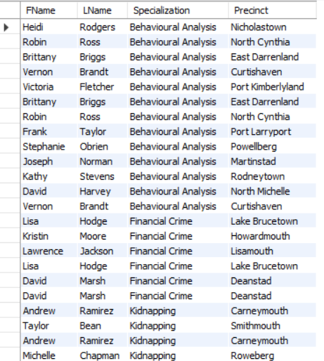
Output:
2. List of Officers Assigned to Drug-Related Cases
To track down officers responsible for active drug-linked investigations for coordination and quick escalation
Code:
Notes:
Next, since drugs were found in the victim’s system, we wanted to see which officers handle drug-related cases.
We joined Officer, Crime, and Forensics, filtered for drug involvement, and sorted the officers by specialization. Most are from Behavioral Analysis, showing a pattern in how such cases are assigned.
This also gives us insight into which officers could be contacted or cross-referenced for potential leads.
For further investigation I will pass it over to Prachi.

Slide 18
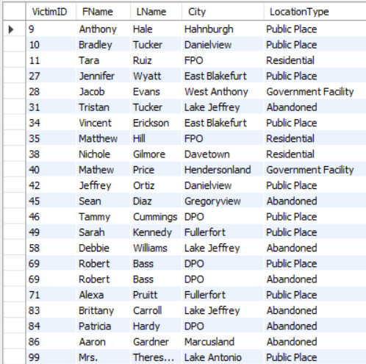
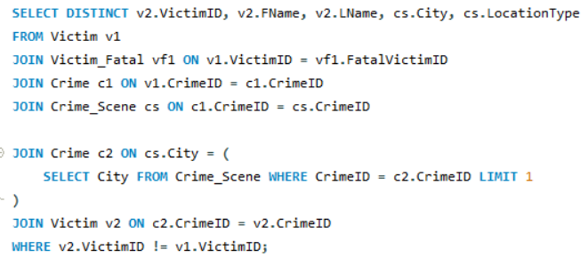
Output:
3. More victims with fatal injuries found in similar locations
Tracking victims who have also had fatal injuries in the same location, as they might have had interaction with the same offender
Code:

Slide 19
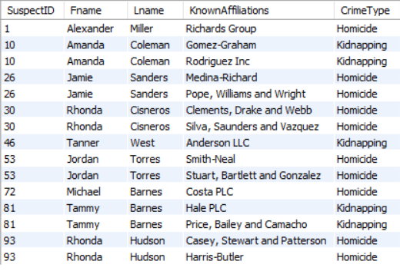
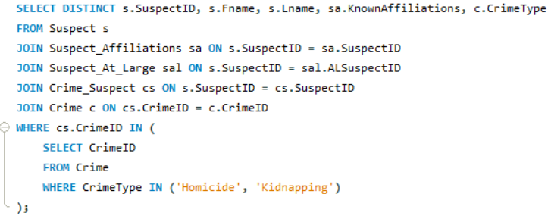
Output:
4. Suspects at large, affiliated with a group, involved in either Homicide or Kidnapping crimes
Tracking down suspects at large and the groups they are affiliated with and figure out if they have been involved in either Homicide or kidnapping crimes
Code:
SQL CODE SQL CODE SQL CODE here here here

Slide 20
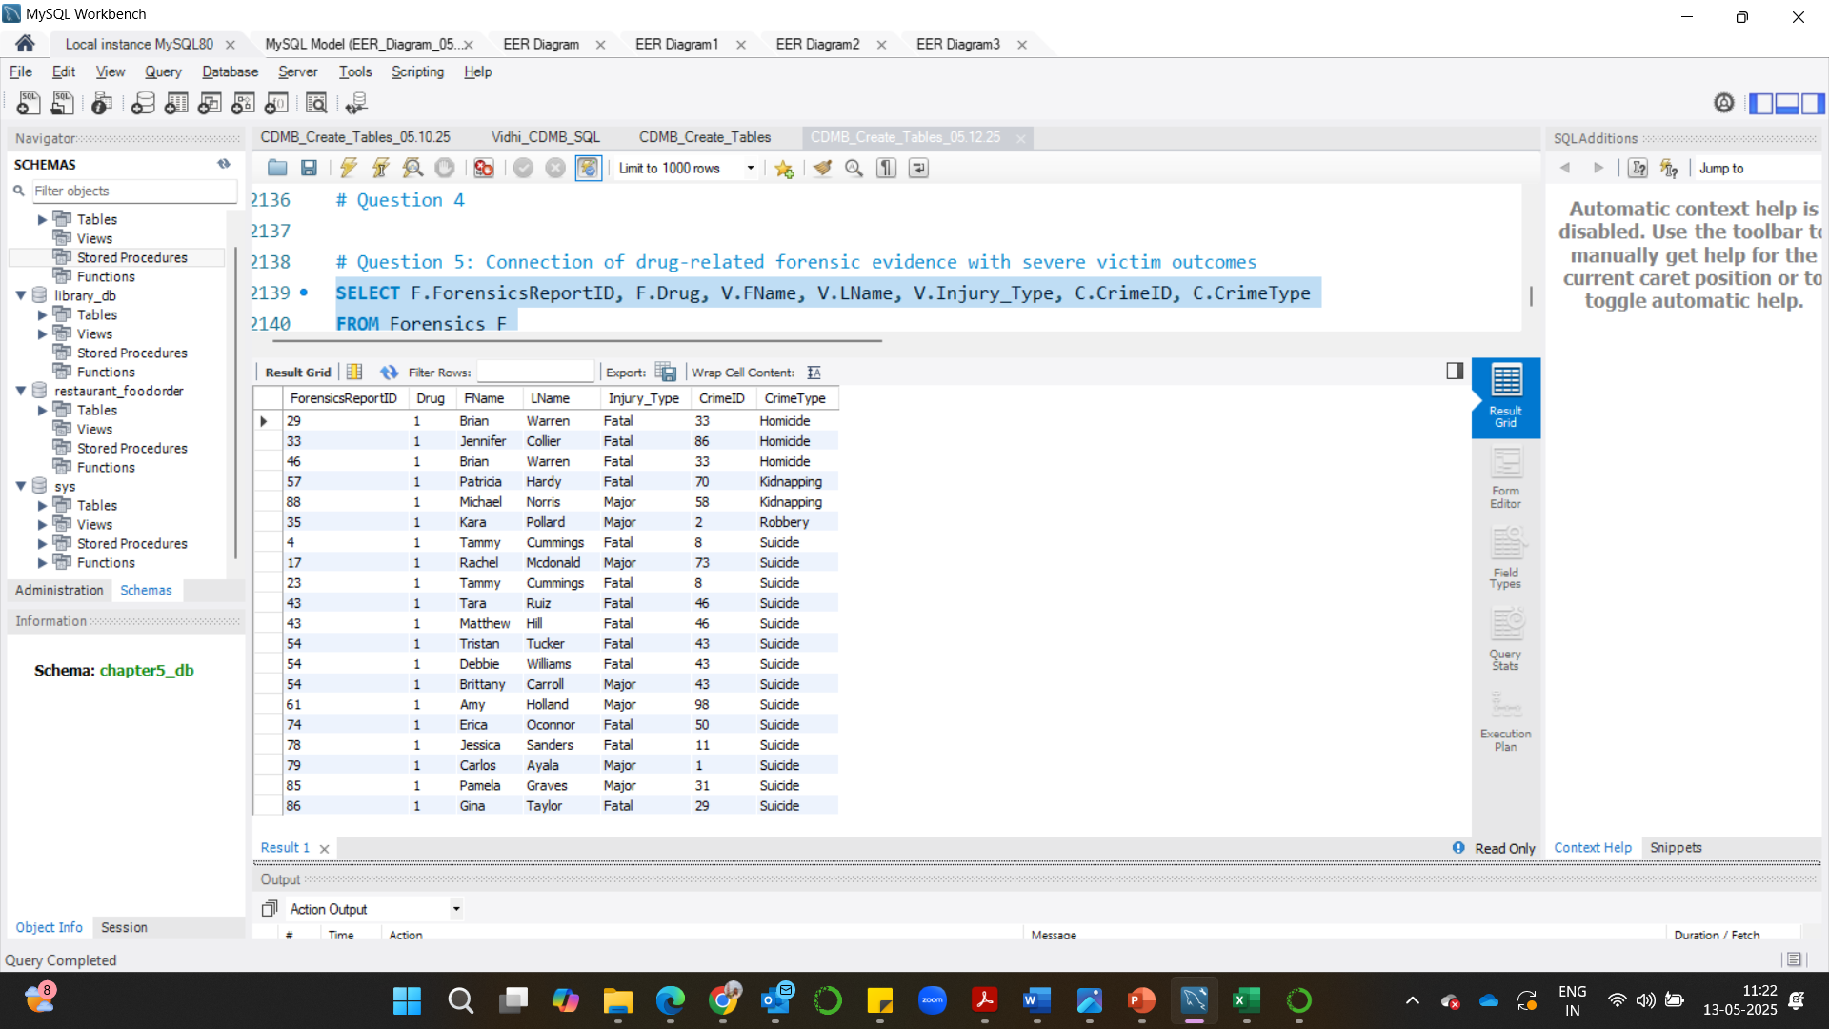
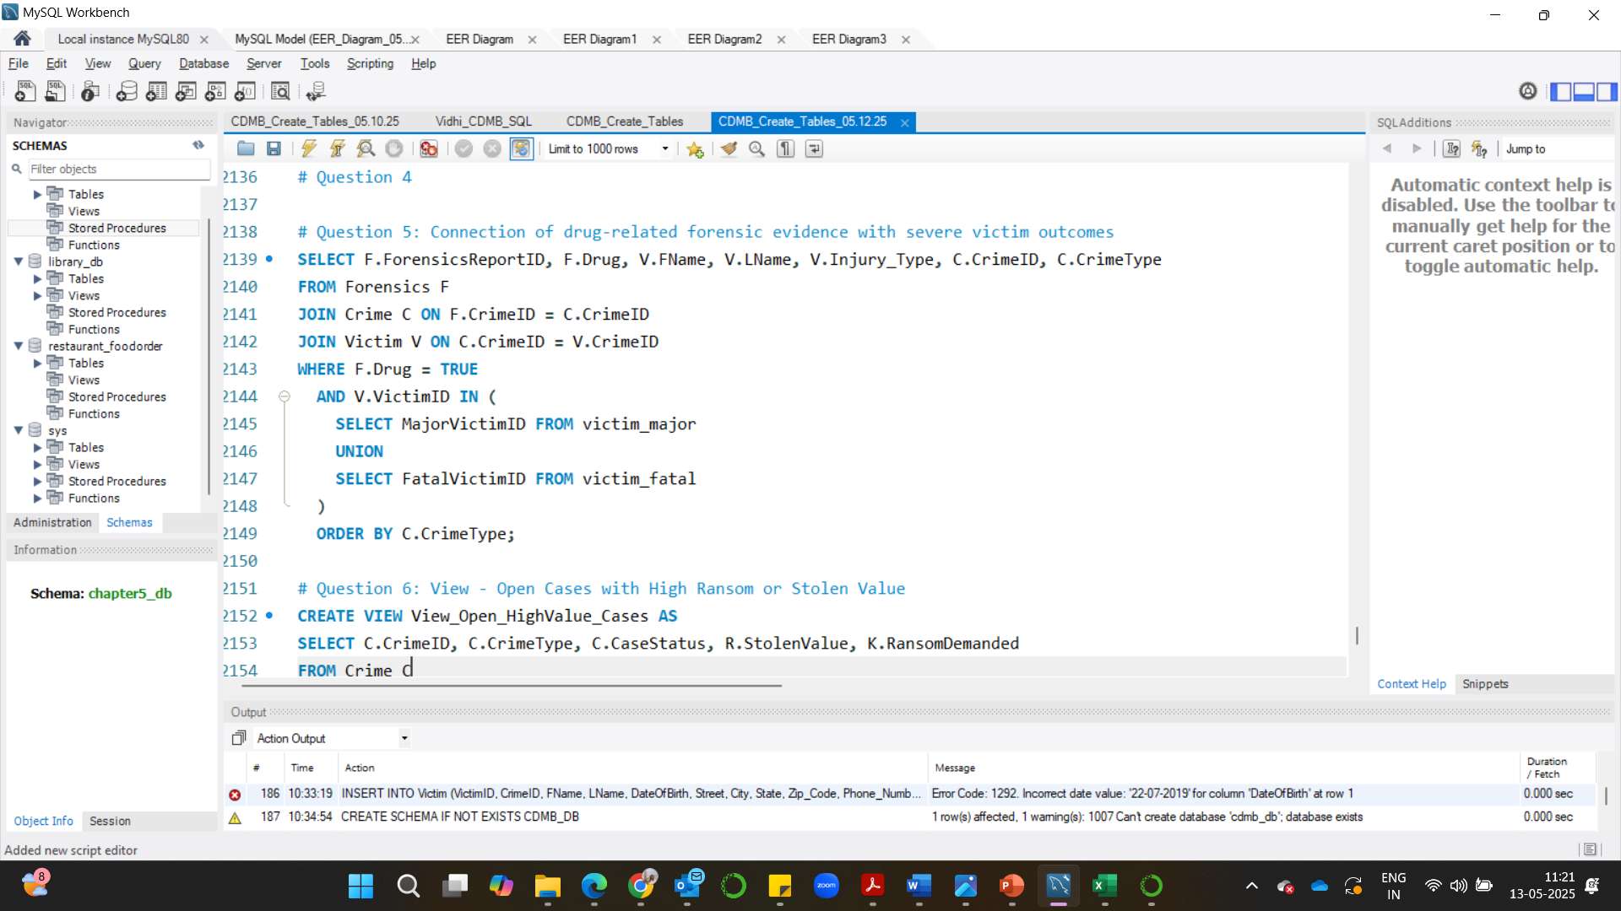
5. Previous forensic reports that detected drug traces associated with crimes where the victim had major or fatal injuries
Output:
Connect drug-related forensic evidence with severe victim outcomes and Crime
Code:

Slide 21
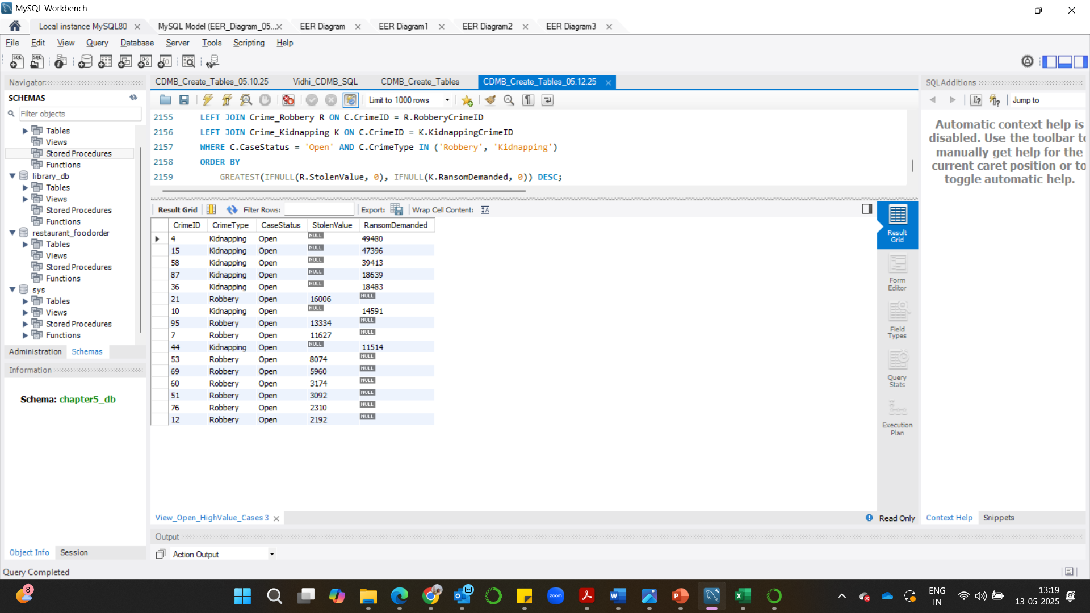
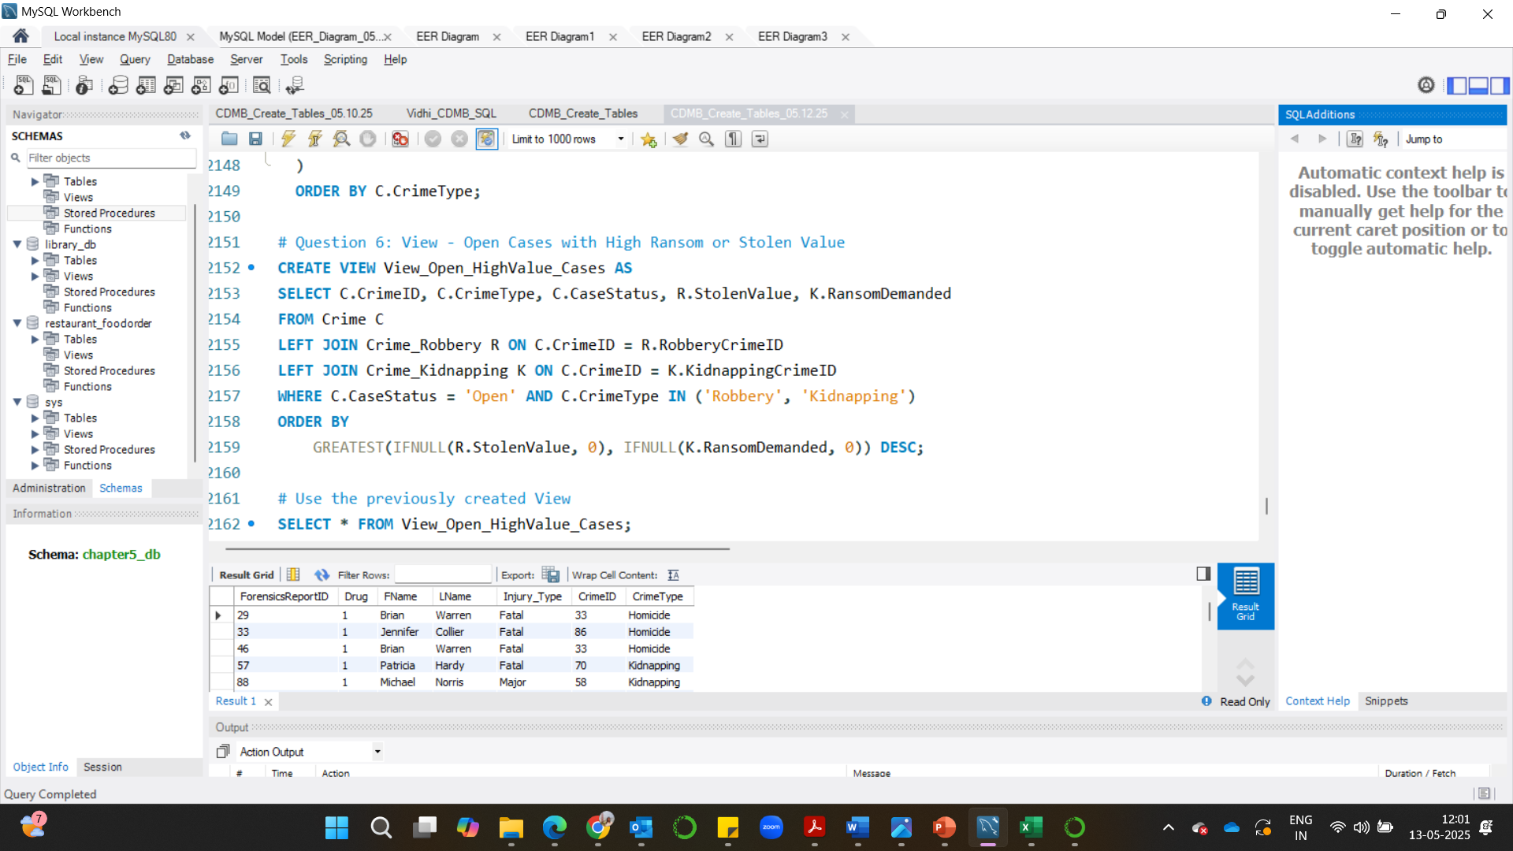
Output:
6. A View to track Open Cases with High Ransom or Stolen Value
To see the possibilities of connecting the current case to the relevant Open cases
Code:

Slide 22
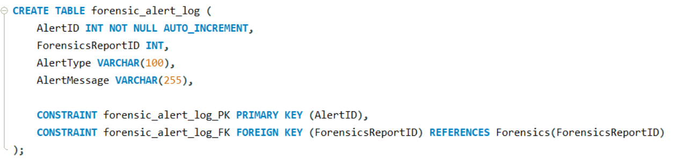
7. Creating an alert when drug or poison evidence is entered into forensics
To automatically generate an alert when toxic substances (drug or poison) are detected in a forensic report
Code:

Slide 23
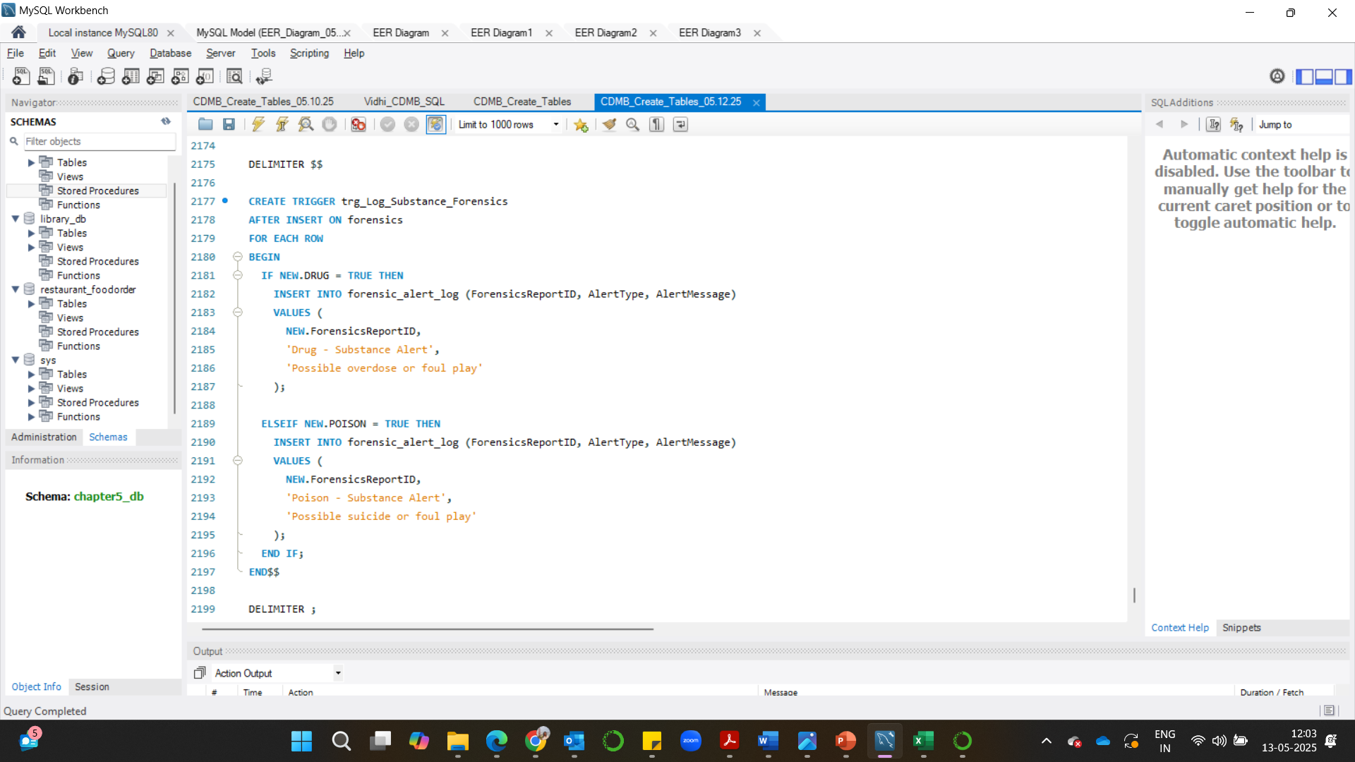
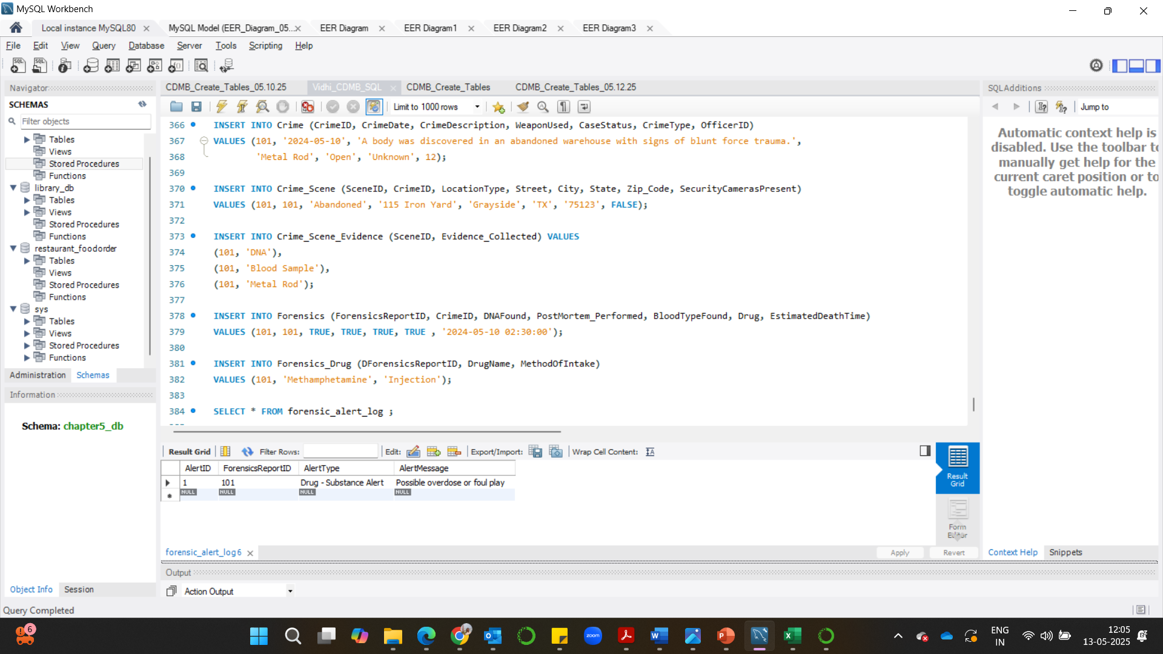
Output:

Slide 24
INVESTIGATION HIGHLIGHTS
Crime Pattern Detection: Identified Homicide and Kidnapping occurrences in commercial areas.
Officer Assignment Tracking: Listed officers handling drug-related cases for rapid coordination.
Victim Profile Matching: Located victims with fatalities found in similar locations.
Affiliated Suspects Monitoring: Tracked at-large suspects affiliated with gangs or organizations involved in homicide or kidnapping.
Forensics Insight: Traced forensic reports showing drug evidence in cases with severe injuries.
High-Value Open Case Tracking: Created a view to monitor robbery/kidnapping cases with high ransom or stolen value.
Real-Time Toxicology Alerts: Built an alert system for drug or poison entries in forensics — enabling early response

Slide 25

CONCLUSION - CASE STATUS
100%
100%
Database Implementation
Entity Linking
Entities, attributes, and subtypes
Composite, and multivalued Attributes
Complex joins and subqueries
Associative table
100%
Analytics Readiness
Designed to support decision-making
Query-driven insights
View and Trigger

Slide 26

Questions?
Case Closed. Do you have follow-up questions?
Thank you for your attention.

